Slide 1
NAT
Chapter 11
Routing and Switching
(CCNA2)

Slide 2
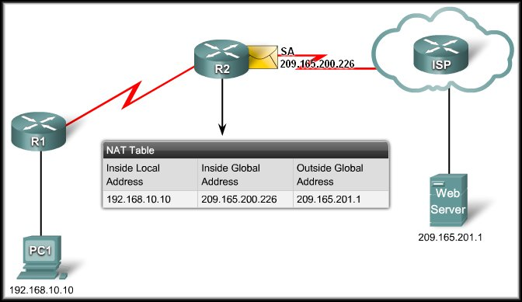
IP Addressing Services
Scaling Networks With Network Address Translation (NAT)

Slide 3
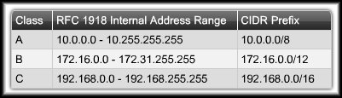
Scaling Networks With NAT
Private Internet Addresses:
  These are reserved private Internet addresses drawn from three blocks.
  These addresses are for private, internal network use only.
  RFC 1918 specifies that private addresses are not to be routed over the Internet.

Slide 4
Scaling Networks With NAT
Private Internet Addresses:
  Two Issues:
    You cannot route
    private addresses over the Internet.
    There are not enough public addresses to allow organizations to provide one to every one of their hosts.
  Networks need a mechanism to translate private addresses to public addresses at the edge of their network that works in both directions.
  Solution – NAT.

Slide 5
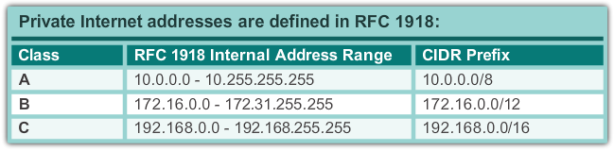
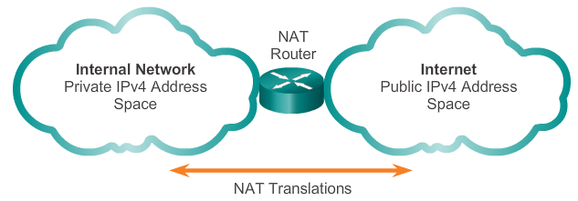
IPv4 Private Address Space
Notes:
11.1.1.1 IPv4 Private Address Space

Slide 6
What is NAT?
Primary use is to conserve public IPv4 addresses.
The DHCP server assigns devices inside the network with private unique addresses.
NAT is usually implemented at border network devices, such as firewalls or routers.
When the client sends packets out of the network, NAT translates the internal private IP address of the client to an external public address.
NAT
Private Address
Public Address

Slide 7
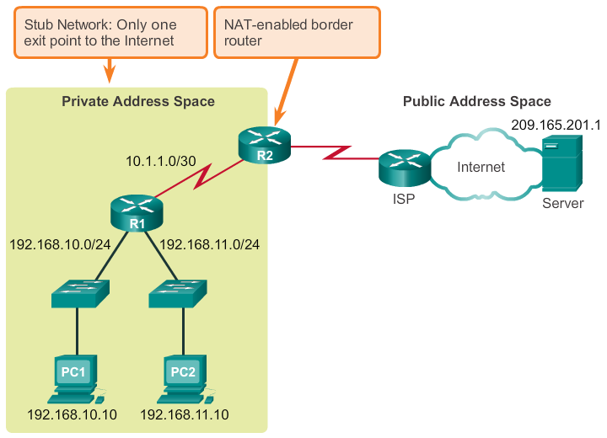
What is NAT? (cont.)
Notes:
11.1.1.2 What is NAT? (cont.)

Slide 8
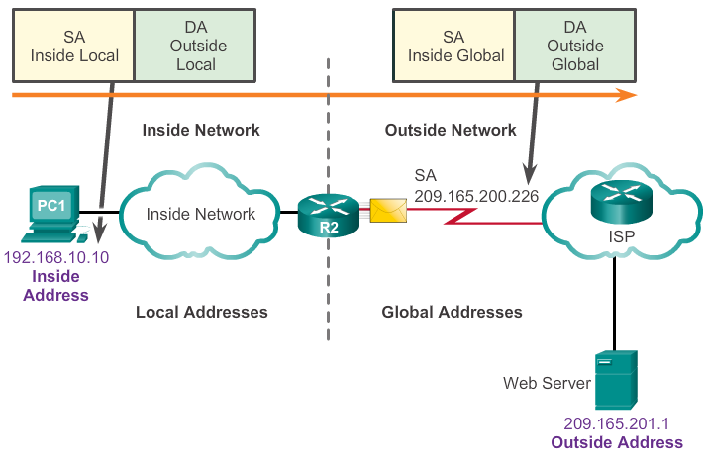
NAT Terminology
Inside network is the set of devices using private addresses
Outside network refers to all other networks
NAT includes four types of addresses:
  Inside local address
  Inside global address
  Outside local address
  Outside global address
Notes:
11.1.1.3 NAT Terminology

Slide 9
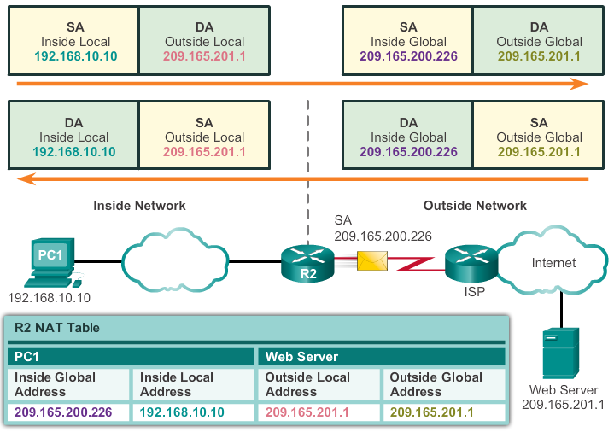
NAT Terminology (cont.)
Notes:
11.1.1.4 NAT Terminology (cont.)

Slide 10
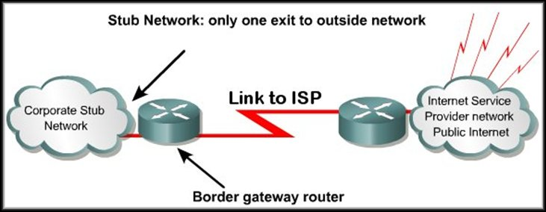
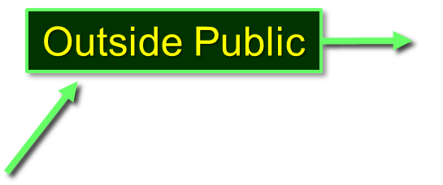
What is NAT?
Inside Private
The translation process uses an internal translation table.
The contents of the table will vary depending on the type of network translation being implemented.
We will be looking at the use of static NAT, dynamic NAT and Port Address Translation (PAT).

Slide 11
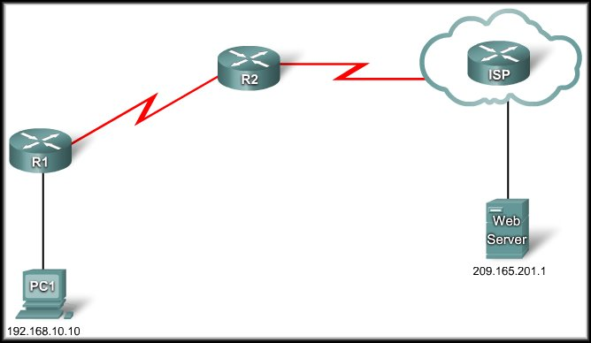
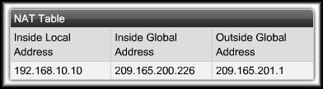
How Does NAT Work?
R2: I have a packet for the outside network.
I must translate the IP address.
Send
209.165.200.226
DA | SA
209.165.201.1 | 209.165.200.226
DA | SA
209.165.201.1 | 192.168.10.10

Slide 12
How Does NAT Work?
R2: I have a packet for the inside network.
I must translate the IP address.
Receive
DA | SA
192.168.10.10 | 209.165.201.1
209.165.200.226
DA | SA
209.165.200.226 | 209.165.201.1

Slide 13
Dynamic Mapping and Static Mapping
NAT Table
Inside Local | Inside Global
10.0.0.1 | 179.9.8.81
10.0.0.2
10.0.0.3
10.0.0.4
10.0.0.5
10.0.0.6
10.0.0.7
10.0.0.8 | 179.9.8.86
Dynamic Mapping:
  Mapping of local addresses
  dynamically to a pool of
  global addresses.
  The hosts able to use NAT is
  limited by the number of
  addresses in the range.
  If you have allocated 6 public
  addresses for NAT, any 6
  users can use NAT simultaneously.
    The NAT device dynamically assigns an address when a request is received. When a session ends, the address is returned to the pool for another user.

Slide 14
Dynamic Mapping and Static Mapping
NAT Table
Inside Local | Inside Global
10.0.0.1 | 179.9.8.81
10.0.0.2 | 179.9.8.82
10.0.0.3 | 179.9.8.83
10.0.0.4 | 179.9.8.84
10.0.0.5 | 179.9.8.85
10.0.0.6 | 179.9.8.86
Static Mapping:
  One to one mapping of local
  and global addresses.
  The hosts able to use NAT is
  limited by the static
  assignment in the table.
  If you have allocated 6 public addresses for NAT, only these 6 users can use NAT.
    No other network users will have access unless you allocate another global address and add it to the table.

Slide 15
NAT Overload
Port Address Translation (PAT):
  Allows you to use a single Public IP address and assign it up to 65,536 inside hosts (4,000 is more realistic).
  Modifies the TCP/UDP source port to track inside host addresses.
  Tracks and translates:
    Source IP Address.
    Destination IP Address.
    TCP/UDP Source Port Number.
  These uniquely identify each connection for each stream of traffic.

Slide 16
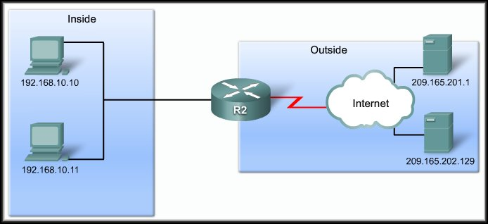
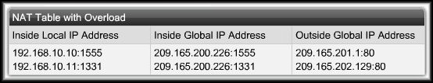
NAT Overload
Port Address Translation (PAT):
209.165.200.226
SA | DA
192.168.10.10:1555 | 209.165.201.1:80
SA | DA
209.165.200.226:1555 | 209.165.201.1:80
SA | DA
209.165.200.226:1331 | 209.165.202.129:80
SA | DA
192.168.10.11:1331 | 209.165.202.129:80

Slide 17
NAT Overload
Port Address Translation (PAT):
209.165.200.226
SA | DA
209.165.201.1:80 | 209.165.200.226:1555
SA | DA
209.165.201.1:80 | 192.168.10.10:1555
SA | DA
209.165.202.129:80 | 192.168.10.11:1331
SA | DA
209.165.202.129:80 | 209.165.200.226:1331

Slide 18
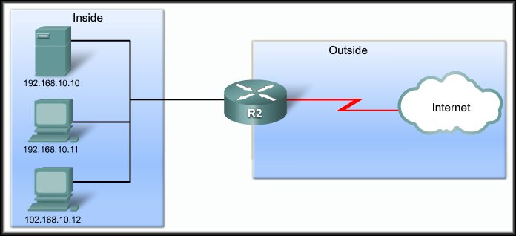

NAT Overload
Port Address Translation (PAT): NEXT AVAILABLE PORT
192.168.10.11:1444
192.168.10.12:1444

Slide 19
Benefits and Drawbacks
NAT Benefits:
  Conserves the legally registered addressing scheme.
  Increases the flexibility of connections to the public network.
  Provides consistency for internal network addressing schemes.
  Provides network security.

Slide 20
Benefits and Drawbacks
NAT Drawbacks:
  Performance is degraded.
  End-to-end functionality is degraded.
  End-to-end trace is lost.
  Tunneling is more complicated.
  Initiating TCP connections can be disrupted.
    TCP initiated from the outside or stateless protocols using UDP.
  Network architectures may have to be rebuilt.

Slide 21
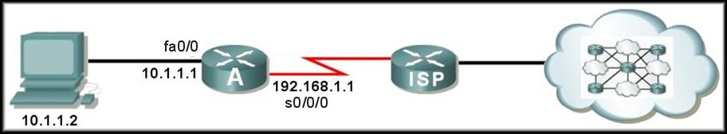

Configuring Static NAT
Step 1:
  Specify static translation between an inside local and inside global address.
  ip nat inside source static
  local-ip global-ip
179.23.2.2 – Inside Global address from ISP.
Port Address
ISP routing table:
179.23.2.0 via 192.168.1.1
RA(config)#ip nat inside source static 10.1.1.2 179.23.2.2

Slide 22
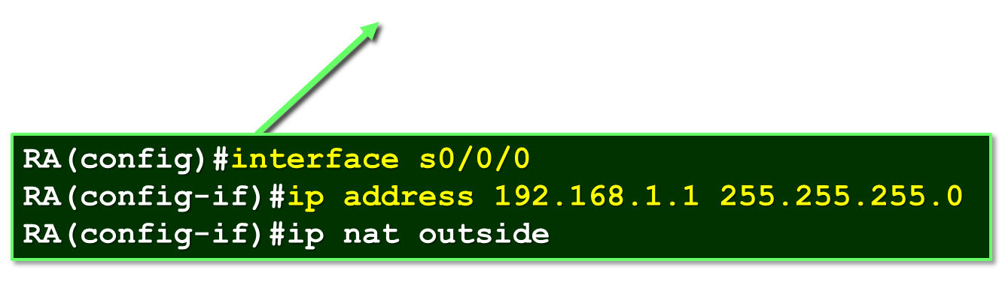
Configuring Static NAT
Step 2:
  Mark the router interfaces as an inside interface or an outside interface.
RA(config)#interface fa0/0
RA(config-if)#ip address 10.1.1.1 255.255.255.0
RA(config-if)#ip nat inside
ISP routing table:
179.23.2.0 via 192.168.1.1

Slide 23
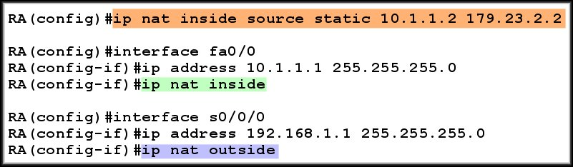
Configuring Static NAT
Summary:
10.1.1.2 will always translate to 179.23.2.2

Slide 24
Configuring Dynamic NAT
  Define a named address pool of outside addresses to be used for translation.
  Define an access list to specify those inside addresses that are eligible for translation.
  Specify dynamic translation between the
  inside addresses allowed by the access list
  and the
  pool of outside addresses.
  Mark the interfaces as inside or outside.

Slide 25
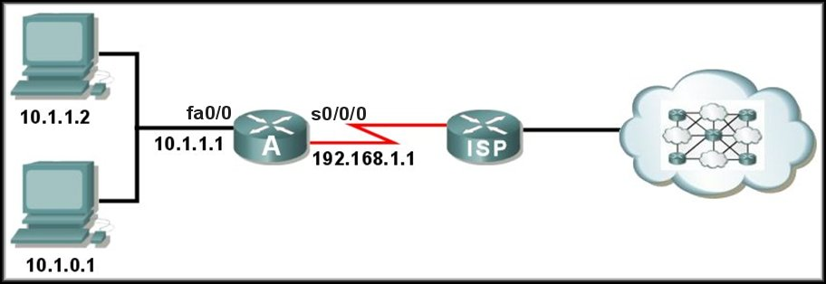
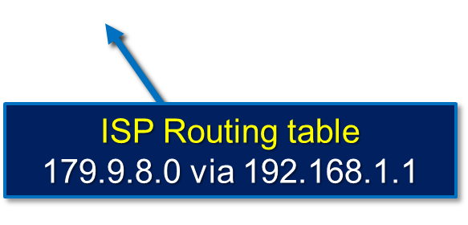
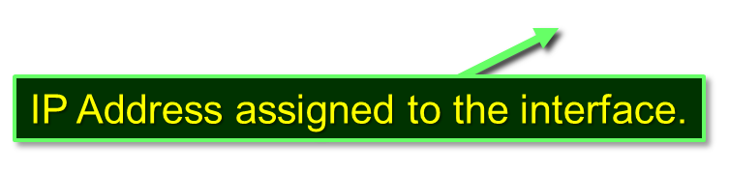
Configuring Dynamic NAT
Step 1:
  Define a named address pool of outside addresses to be used for translation.
  ip nat pool name start-ip end-ip
  (netmask netmask |
  prefix-length prefix-length)
Address space from ISP = 179.9.8.0/24

Slide 26
Configuring Dynamic NAT
Step 1:
  Define a named address pool of outside addresses to be used for translation.
  ip nat pool NAT-POOL1 179.9.8.80 179.9.8.85
  netmask 255.255.255.0
Range
Name
Mask
Address space from ISP = 179.9.8.0/24

Slide 27
Configuring Dynamic NAT
Step 2:
  Define an access list to specify those inside addresses that are eligible for translation.
  access-list access-list-number
  permit source [source wildcard]
Address space from ISP = 179.9.8.0/24

Slide 28
Configuring Dynamic NAT
Step 2:
  Define an access list to specify those inside addresses that are eligible for translation.
  access-list 1 permit 10.1.0.0 0.0.255.255
Allows ALL inside network addresses to be translated.
Address space from ISP = 179.9.8.0/24

Slide 29
Configuring Dynamic NAT
Step 2:
  Specify dynamic translation between the inside addresses allowed by the access list and the
  pool of outside addresses.
  ip nat inside source list access-list-number
  pool pool-name
Address space from ISP = 179.9.8.0/24

Slide 30
Configuring Dynamic NAT
Step 3:
  Specify dynamic translation between the inside addresses allowed by the access list and the
  pool of outside addresses.
  ip nat inside source list 1 pool NAT-POOL1
From Step 1
From Step 2
Address space from ISP = 179.9.8.0/24

Slide 31
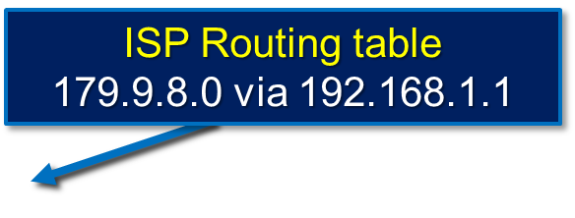
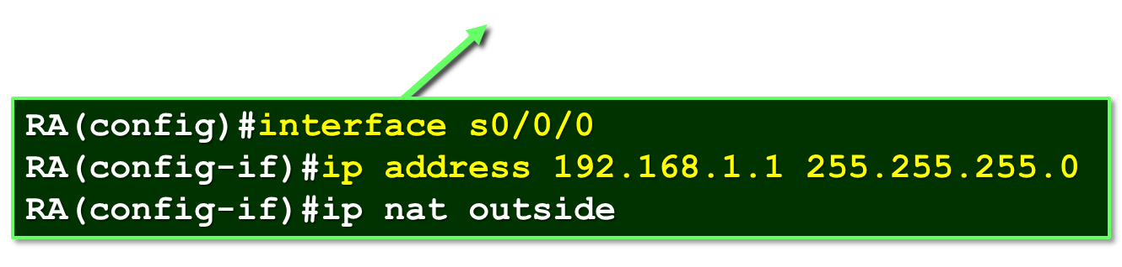
Configuring Dynamic NAT
Step 4:
  Mark the interfaces as inside or outside.
RA(config)#interface fa0/0
RA(config-if)#ip address 10.1.1.1 255.255.255.0
RA(config-if)#ip nat inside

Slide 32
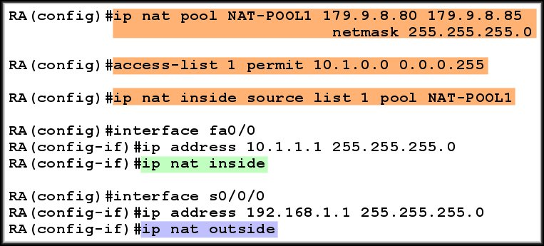
Configuring Dynamic NAT
All inside hosts are eligible for NAT.
Summary:

Slide 33
Configuring NAT Overload (PAT)
There are two possible ways to configure overloading.
  It depends on how the ISP allocates public IP addresses.
    The ISP allocates one public IP address to the organization.
    The ISP allocates more than one public IP address.
    In either case, the configuration will include the overload keyword.
      This keyword specifies to the router that Port Address Translation (PAT) is to be used.

Slide 34
Configuring NAT Overload (PAT)
The ISP allocates one public IP address to the organization.
  Assign the IP address received from the ISP as the IP address of the outside interface.
  Define a standard access list permitting those addresses to be translated.
  Establish dynamic translation specifying the access list and the actual interface instead of a pool of addresses and include the overload keyword.
  Identify the inside and outside interfaces.

Slide 35
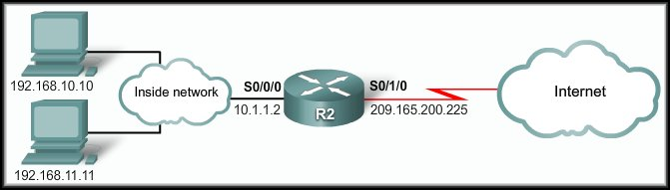
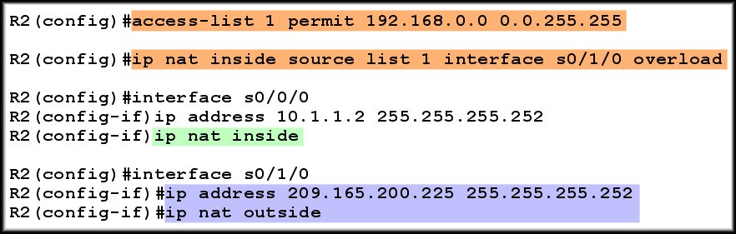
Configuring NAT Overload (PAT)
The ISP allocates one public IP address to the organization.
Assigned by ISP

Slide 36
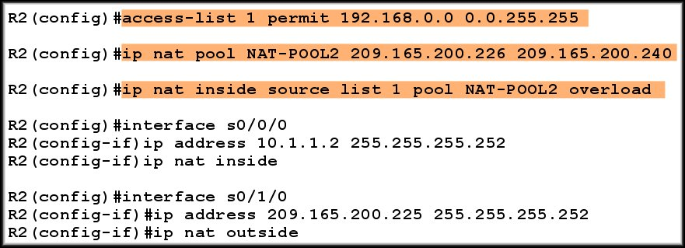
Configuring NAT Overload (PAT)
The ISP allocates more than one public IP address.

Slide 37
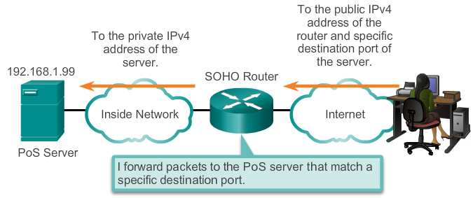
Port Forwarding
Port forwarding is the act of forwarding a network port from one network node to another.
A packet sent to the public IP address and port of a router can be forwarded to a private IP address and port in inside network.
Port forwarding is helpful in situations where servers have private addresses, not reachable from the outside networks.
Notes:
11.2.4.1 Port Forwarding

Slide 38
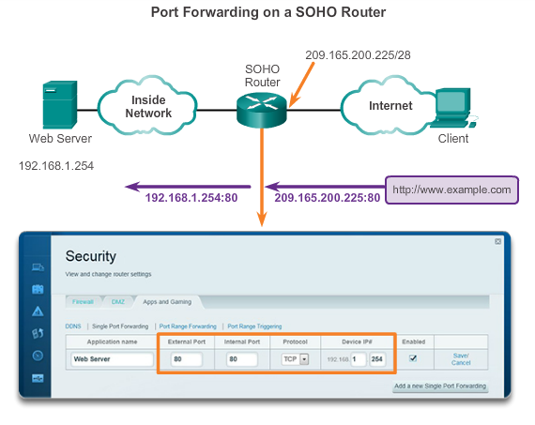
SOHO Example
Notes:
11.2.4.2 SOHO Example

Slide 39
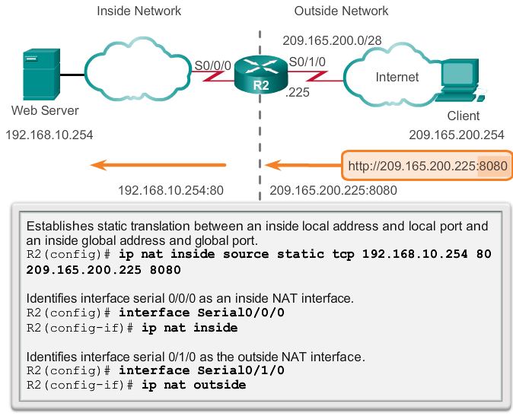
Configuring Port Forwarding with IOS
In IOS, Port forwarding is essentially a static NAT translation with a specified TCP or UDP port number.
Notes:
11.2.4.3 Configuring Port Forwarding with IOS

Slide 40
Port Forwarding

Slide 41
NAT for IPv6?
NAT is a workaround for IPv4 address scarcity.
IPv6 with a 128-bit address provides 340 undecillion addresses.
Address space is not an issue for IPv6.
IPv6 makes IPv4 public-private NAT unnecessary by design; however, IPv6 does implement a form of private addresses, and it is implemented differently than they are for IPv4.
Notes:
11.2.5.1 NAT for IPv6?

Slide 42
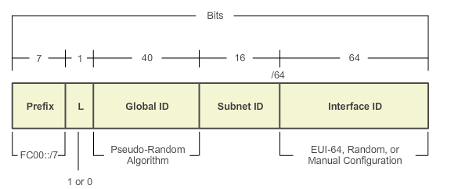
IPv6 Unique Local Addresses
IPv6 unique local addresses (ULAs) are designed to allow IPv6 communications within a local site.
ULAs are not meant to provide additional IPv6 address space.
ULAs have the prefix FC00::/7, which results in a first hextet range of FC00 to FDFF.
ULAs are also known as local IPv6 addresses (not to be confused with IPv6 link-local addresses).
Notes:
11.2.5.2 IPv6 Unique Local Addresses

Slide 43
NAT for IPv6
IPv6 also uses NAT, but in a much different context.
In IPv6, NAT is used to provide transparent communication between IPv6 and IPv4.
NAT64 is not intended to be a permanent solution; it is meant to be a transition mechanism.
Network Address Translation-Protocol Translation (NAT-PT) was another NAT-based transition mechanism for IPv6, but is now deprecated by IETF.
NAT64 is now recommended.
Notes:
11.2.5.3 NAT for IPv6

Slide 44
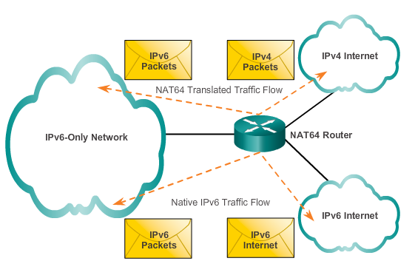
NAT for IPv6
Notes:
11.2.5.3 NAT for IPv6

Slide 45
Troubleshooting NAT
Notes:
11.3 Troubleshooting NAT

Slide 46
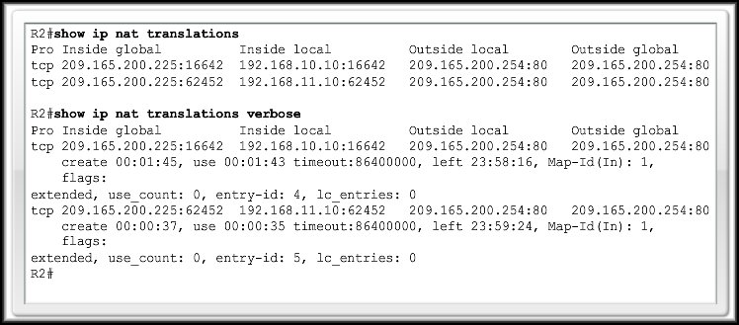
Verifying NAT and NAT Overload
show ip nat translations

Slide 47
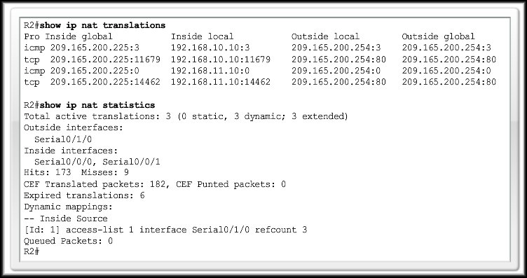
Verifying NAT and NAT Overload
show ip nat statistics

Slide 48
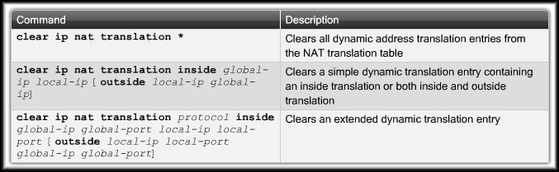
Verifying NAT and NAT Overload
clear ip nat translation

Slide 49
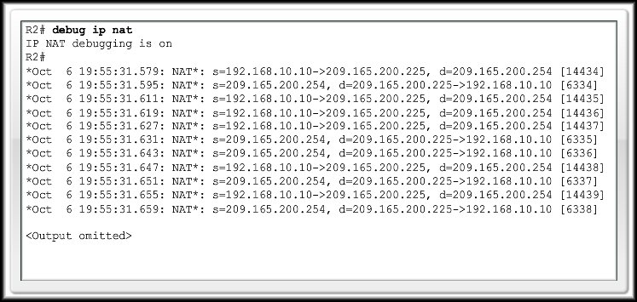
Troubleshooting NAT and NAT Overload
show ip nat translations
clear ip nat translation
debug ip nat

